Slide 1

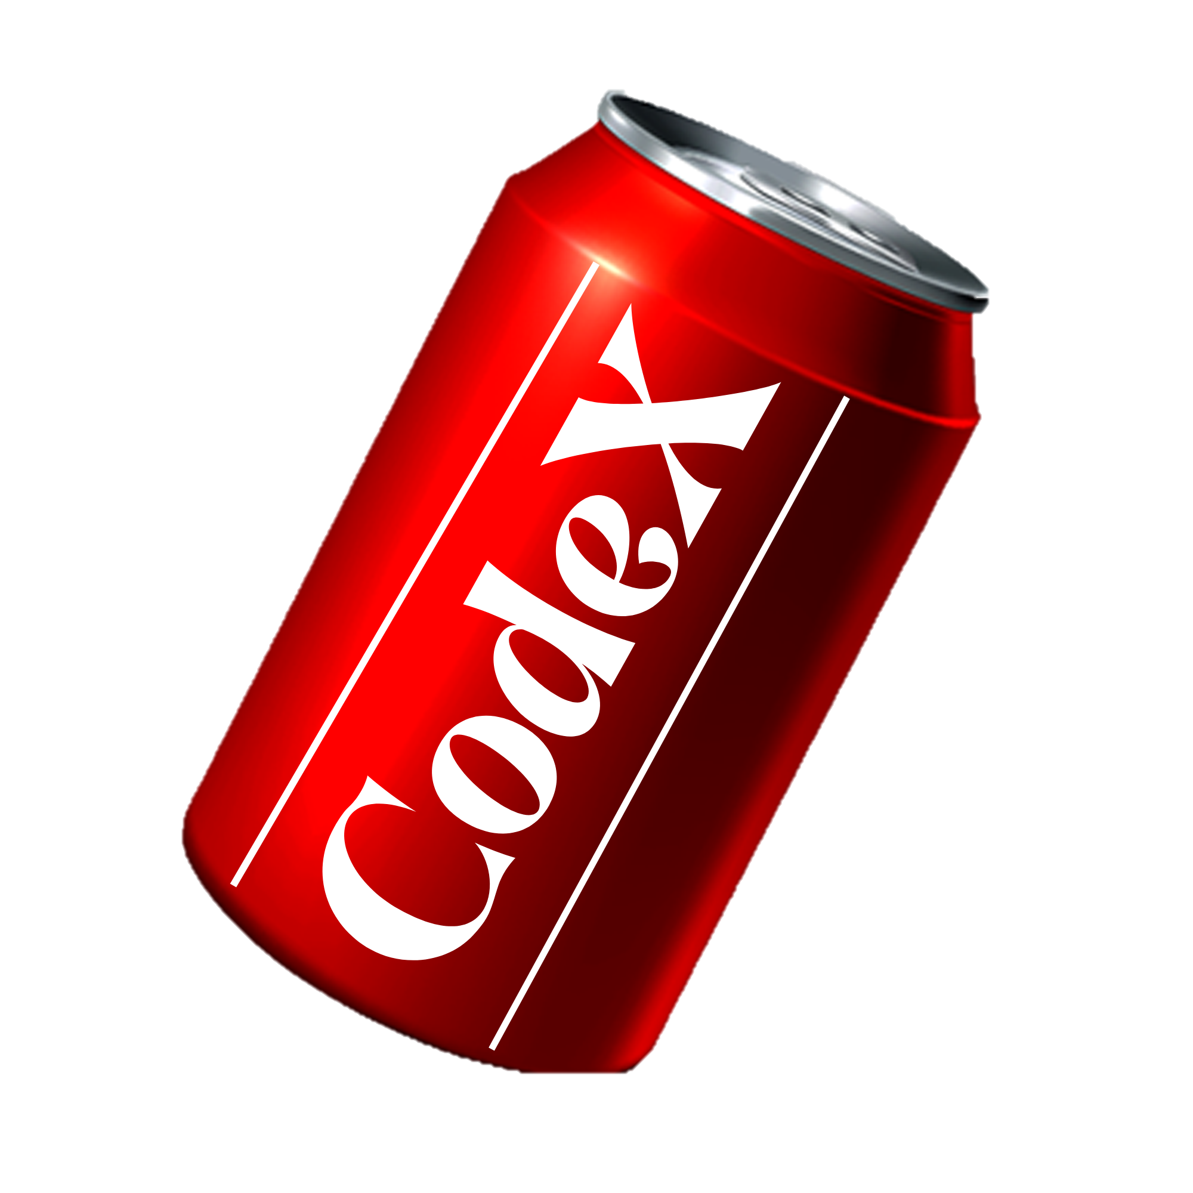
RESUME PROJECT CHALLENGE 6
Challenge : Provide Insights to the Marketing Team in Food & Beverage Industry
Venkata Naga Sai Munagala
Marketing insights by

Slide 2
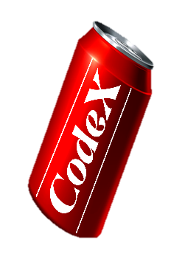
Company Overview
Objectives
Data cleansing
AGENDA
Market Analysis
Insights
Recommendations

Slide 3
COMPANY OVERVIEW
Domain: Food & Beverage
CodeX, a German beverage company, has set its sights on establishing a strong presence in the Indian market.
Recently, they introduced their energy drink across 10 cities in India, marking their entry into this vibrant market.
Playing a crucial role in driving the company's growth, the Marketing team at CodeX is dedicated to enhancing brand recognition, expanding market share, and fostering product development.
In pursuit of these goals, they undertook an extensive survey across the 10 cities, gathering valuable insights from a substantial pool of 10,000 respondents.

Slide 4


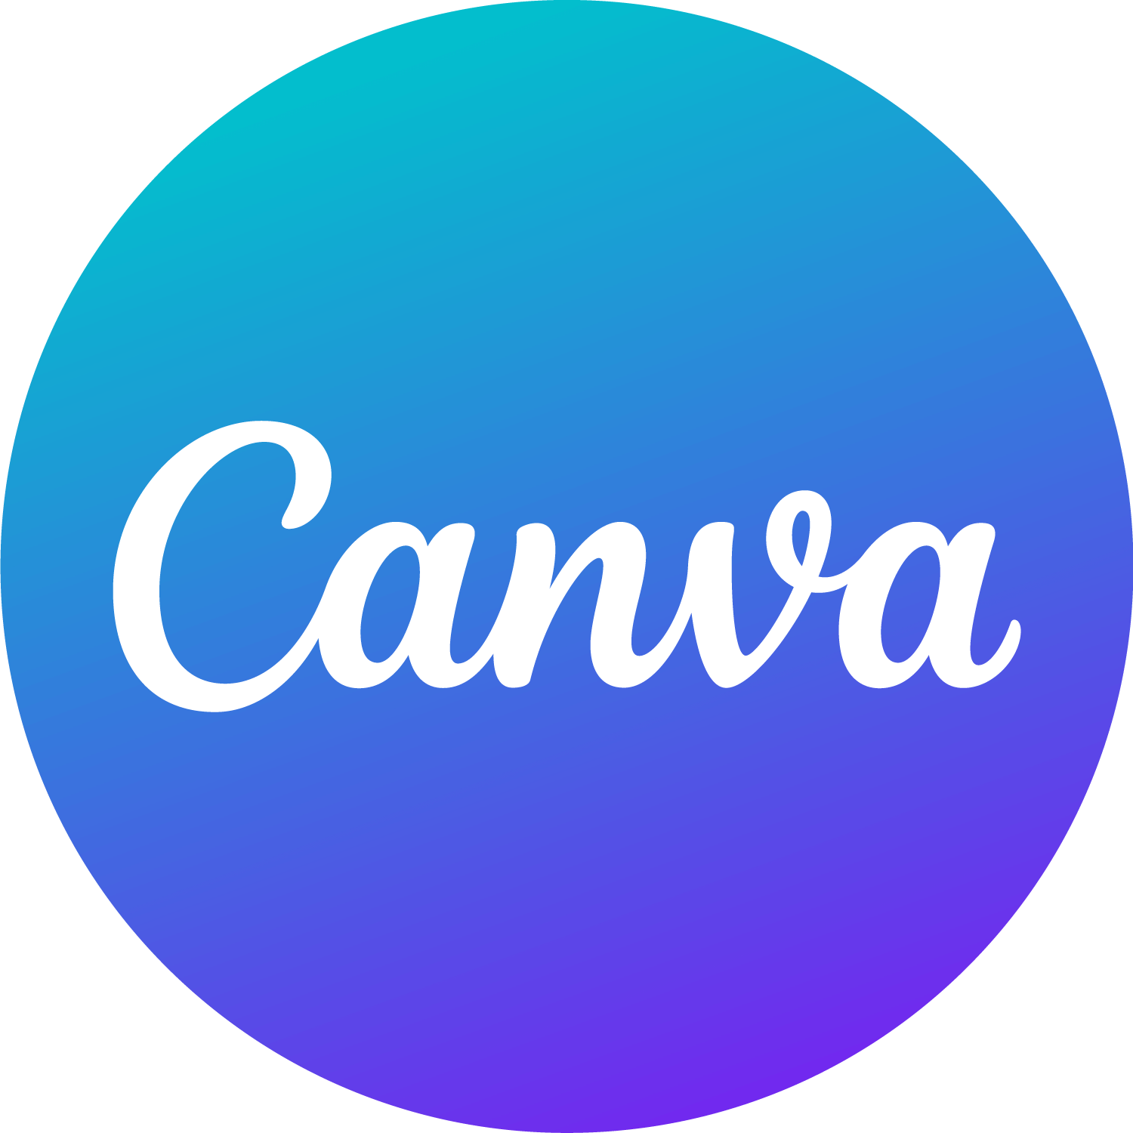
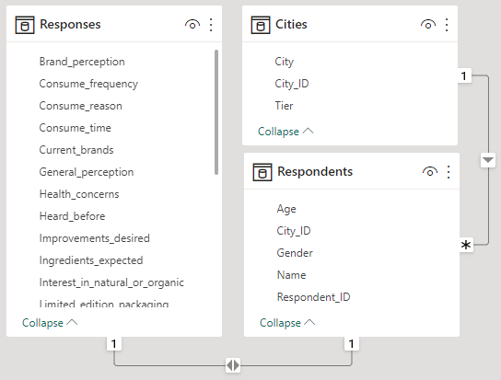
OBJECTIVES
Tools Used:
In the role of Peter Pandey, a marketing data analyst, convert the survey results to meaningful insights which the team can use to drive actions.
Prepare concise and impactful presentation to highlight key insights for the Chief Marketing Officer.
Datasets Provided:

Slide 5
Data Cleansing
Heard before : “No” Then Tried before : “No”
=Table.ReplaceValue(#" Replaced Value ", each [Tried_before],
each if [Heard_before]="No" then "No" else [Tried_before],
Replacer.ReplaceText,{"Tried_before"})
Heard before : “No” Then
Brand Perception : “Neutral”
= Table.ReplaceValue(#"Replaced Value", each [Brand_perception],
each if [Heard_before]="No" then "Neutral" else [Brand_perception],
Replacer.ReplaceText,{"Brand_perception"})
Tried before : “No” Then
Taste Experience: null
= Table.ReplaceValue(#"Replaced Value", each [Taste_experience],
each if [Tried_before]="No" then null else [Taste_experience],
Replacer.ReplaceValue,{"Taste_experience"})

Slide 6











Competitors
Blue Bull, Bepsi, Sky 9, Cola-Coka, Gangster
Alternatives
Herbal tea, Fruit Juices, Coconut water, Electrolytes, Coffee / Tea
MARKET ANALYSIS
Distribution Channels
Supermarkets, Retail outlets, Online stores, Gyms / Sports
centers
Online Ads, TV commercials, Outdoor billboards, Print Media, Social Media , Word of Mouth
Marketing Channels:
Consumption Reason
Increased energy and focus, To boost performance, To combat fatigue, To enhance sports performance

Slide 7
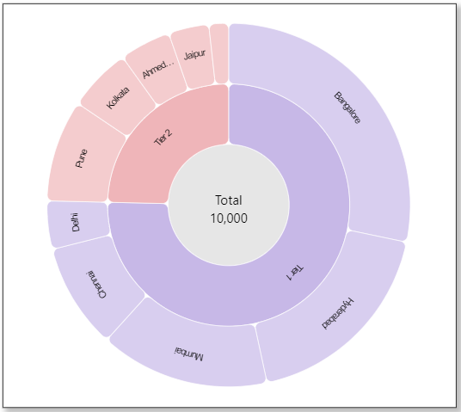
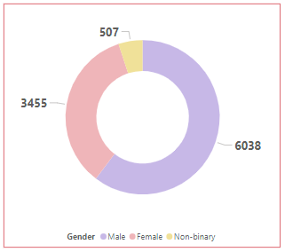
Survey Focus

Slide 8
Demographic Insights
Consumer Preferences
Competition Analysis
PRIMARY INSIGHTS
Marketing Channels and Brand Awareness
Brand Penetration
Purchase Behavior
Product Development

Slide 9
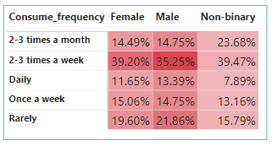
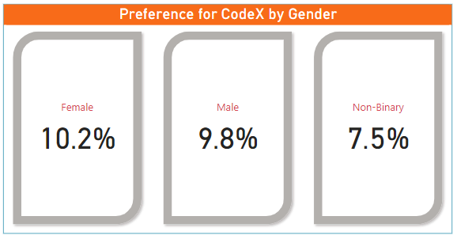
DEMOGRAPHIC INSIGHTS
Who prefers energy drink more(based on gender) ?
Both male and female prefer energy drinks 2-3 times a week and percent of males preferring energy drink on daily is slightly higher compared to females.
The analysis indicates that CodeX has a moderate preference among both males and females, with 9.8% of males and 10% of females preferring the brand.

Slide 10
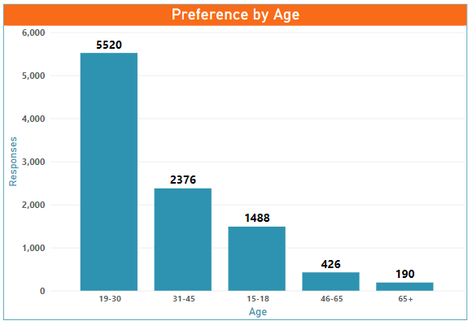
Which age group prefers energy drinks more?
Target age Group : 19 - 30
To maximize reach and impact, collaborating with influential social media personalities / Celebrities can be a valuable approach.

Slide 11
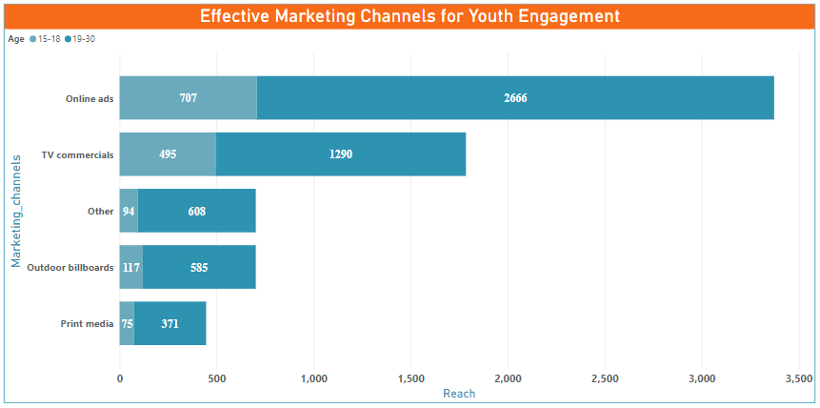
Which type of marketing reaches the most Youth (15-30)?
Online ads offer targeted reach, interactivity, personalization, and trackable results.
TV commercials reach a broader audience, create brand awareness, and leverage storytelling and visuals.

Slide 12
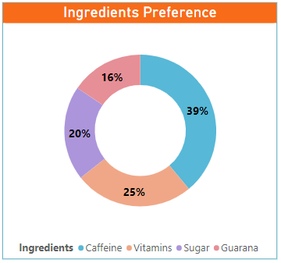
CONSUMER PREFERENCES:
What are the preferred ingredients of energy drinks among respondents ?
Caffeine has been the preferred choice for energy drinks, largely due to its instant stimulating effects.
Aim to educate consumers about Guarana – Natural caffeine
Enrich the energy drink with vitamins and antioxidants

Slide 13
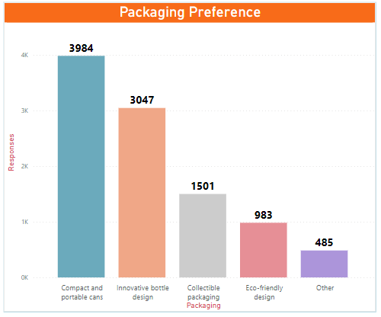
What packaging preferences do respondents have for energy drinks?
Sleek and compact packaging
Ergonomic and visually appealing designs
Eco-friendly materials like plant-based plastics or compostable packaging

Slide 14
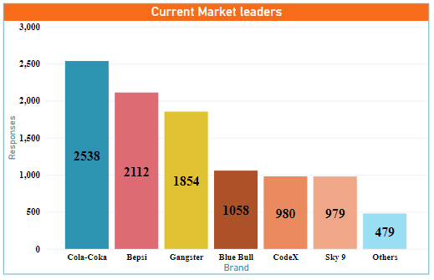
COMPETITION ANALYSIS
Who are the current market leaders?
Market leaders, such as Cola-Coka with 25% market share, Bepsi with 21%, and Gangster with 18%, dominate the energy drinks market
Leverage strategies such as product differentiation, product innovation, and price competitiveness.

Slide 15
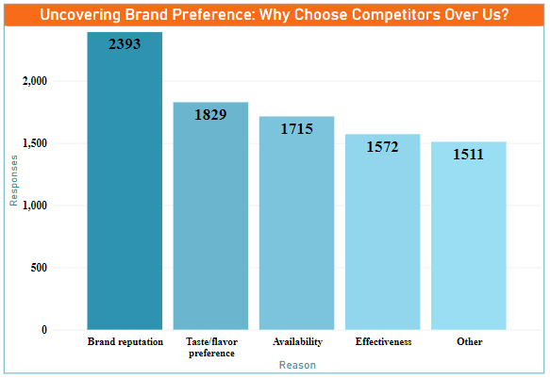
What are the primary reasons consumers prefer those brands over ours?
90.2% of surveyed participants choose competitors over CodeX due to the following reasons
23.93% - reputation and brand image.
18.29% - taste and flavor.
17.15% - Accessible in the market
15.72% Competitor effectiveness

Slide 16
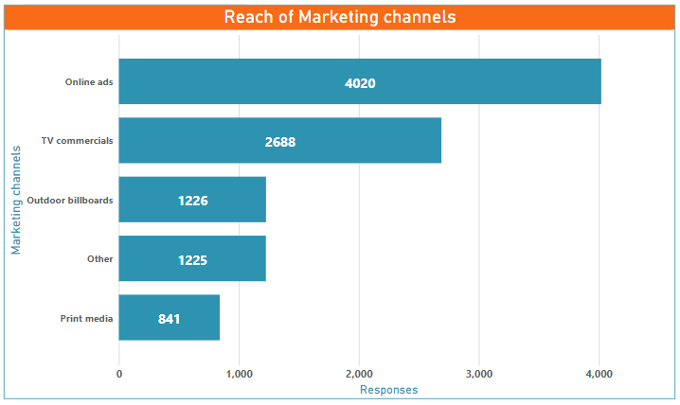
MARKETING CHANNELS AND BRAND AWARENESS:
Which marketing channel can be used to reach more customers?
Dominance: Online Ads and TV commercials
Online Ads - Prominent websites or YouTube videos
TV commercials - Celebrities or prominent sports personalities
Outdoor Billboard at Gyms and Offices'

Slide 17
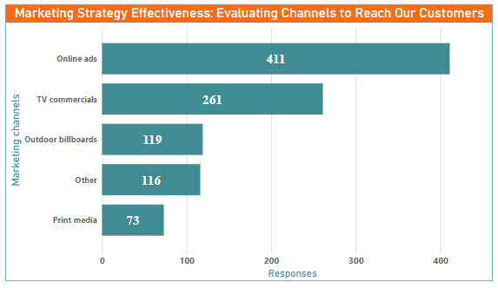
How effective are different marketing strategies and channels in reaching our customers?
Online advertisements demonstrated efficacy for a total of 411 respondents
TV commercials exerted a notable influence on 261 respondents.
Outdoor billboards garnered recognition from 119 respondents,

Slide 18
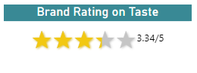
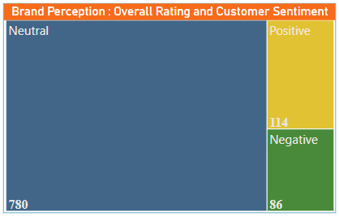
BRAND PENETRATION:
What do people think about our brand? (overall rating)
Room for improvement exists in terms of taste to meet the preferences of our target consumers
The neutral perception of most consumers indicates the potential for enhancing our brand through product modifications tailored to their preferences

Slide 19
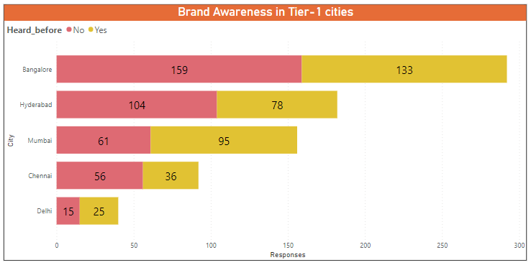
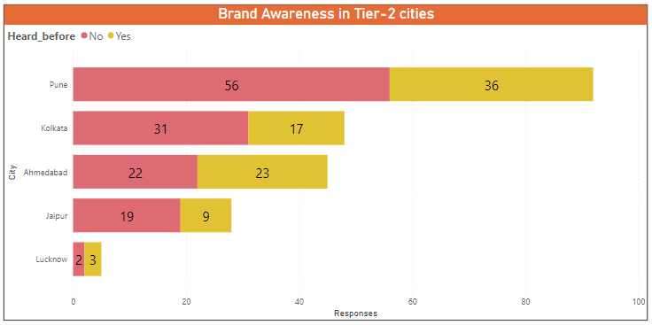
Which cities do we need to focus more on?
Take proactive measures to introduce our product to potential customers to help driving brand recognition and growth.
Prioritize metropolitan cities

Slide 20
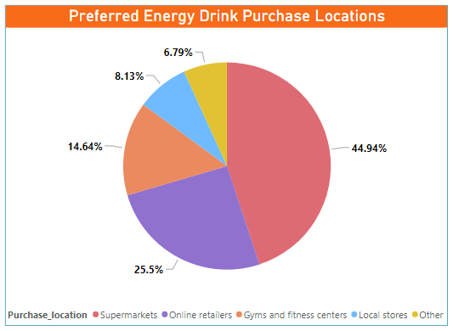
PURCHASE BEHAVIOUR:
Where do respondents prefer to purchase energy drinks
Main Areas of focus : Super markets, Online Retailers
Partnerships and collaborations with supermarkets
Website Optimization, Partnering with online retailers
Exclusive deals to Gym and Fitness Centers
Strong relationships with local stores
Tailored Marketing Strategies

Slide 21
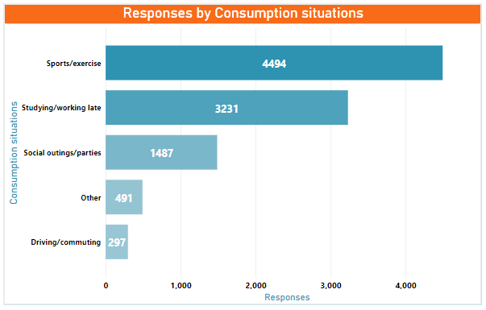
What are the typical consumption situations for energy drinks among respondents?
Partner with fitness centers, sports clubs, and athletic events to promote our energy drinks.
Explore targeted online advertising and partnerships with study-related platforms or study-focused influencers
Offer attractive promotions or bundle deals for group purchase

Slide 22
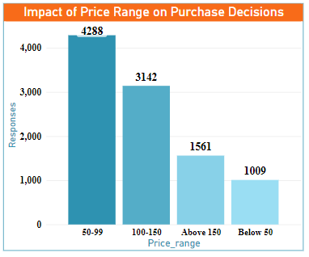
What factors influence respondents' purchase decisions, such as price range and limited edition packaging?
Assess and expand offerings within the
50-99 price range.
Develop strategies to highlight the value of products in the 100-150 price range.
Niche offerings – Price range above 150.
Product Volume variants – Price below 50

Slide 23
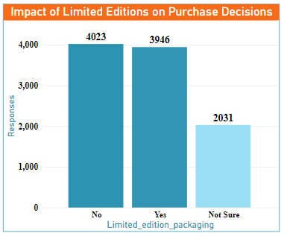
Always follow Test marketing with limited editions
Refine development and marketing strategies based on consumer feedback.
Target consumers valuing exclusivity and novelty.

Slide 24
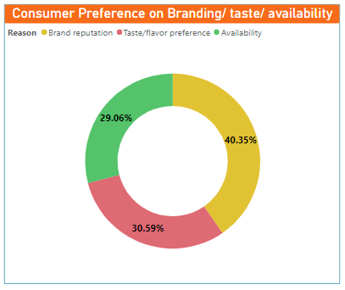
PRODUCT DEVELOPMENT:
Which area of business should we focus more on our product development? (Branding/taste/availability)
Branding >Taste/flavor preferences > Availability
Focus on enhancing the brand's recognition, reputation, and positioning.
Address taste and availability to create a well-rounded product.
Increase Product Accessibility

Slide 25
Barriers to trying our product
Market Leader Analysis
SECONDARY INSIGHTS
Desired Enhancements
Consume time & Reason Analysis

Slide 26
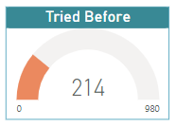
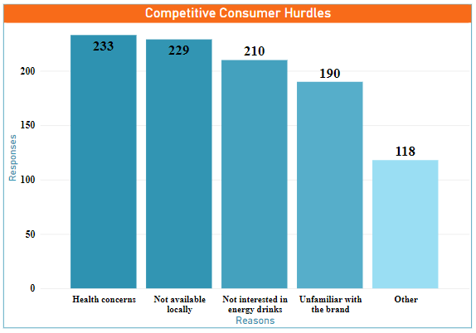
BARRIERS TO TRYING OUR PRODUCT :
What factors hinder consumers from choosing our product over competitors'?
Stay Transparent – Communicate health benefits and safety measures.
Expand distribution networks.
Diversify the product to appeal to a broader audience.
Build brand awareness through targeted marketing campaigns and strategic partnerships.

Slide 27
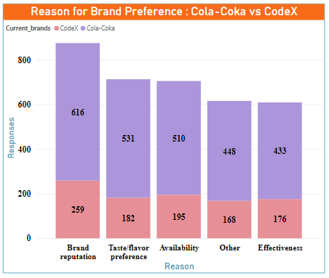
Market Leader Analysis :
Prioritize delivering exceptional customer experiences at every touchpoint to increase Brand reputation
Offer a diverse range of flavors and tastes to cater to a wide customer base.
Tailor your products, marketing campaigns, and distribution strategies to expand the market

Slide 28
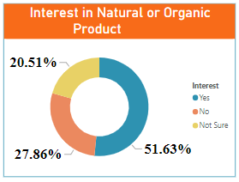
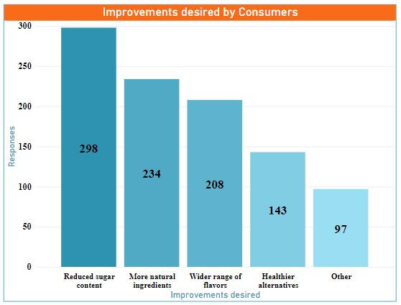
DESIRED ENHANCEMENTS:
What Key Improvements are Sought for Our Health Drink?
Reduce sugar content to meet consumer preference for healthier options
Incorporate natural, minimally processed ingredients and consider including Guarana / Ginseng .
Position the brand as a provider of healthier choices to tap into the growing demand for natural and nutritious products.

Slide 29
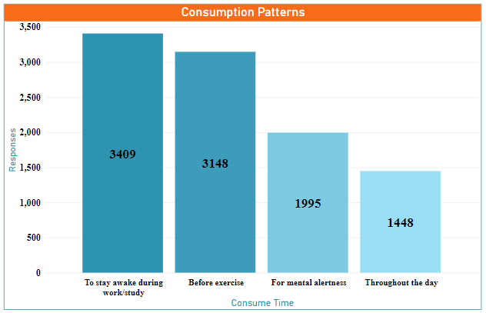
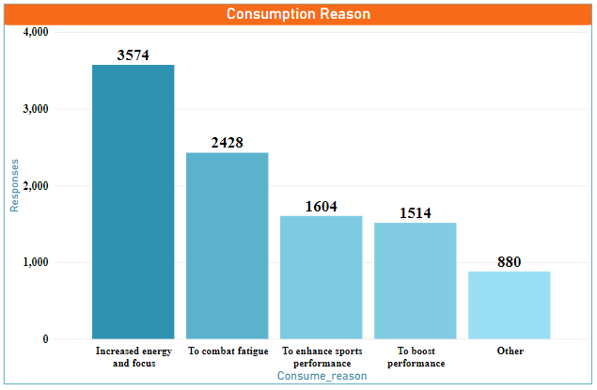
Consume time & Reason Analysis:
What are the consumption patterns and reasons behind consuming energy drinks?
Consumer preferences highlight the need for energy drinks that provide increased energy, enhanced focus, and combat fatigue during work/exercise

Slide 30
Product diversification
Pricing Strategy
RECOMMENDATIONS
Distribution Channel Analysis
Other Recommendations

Slide 31
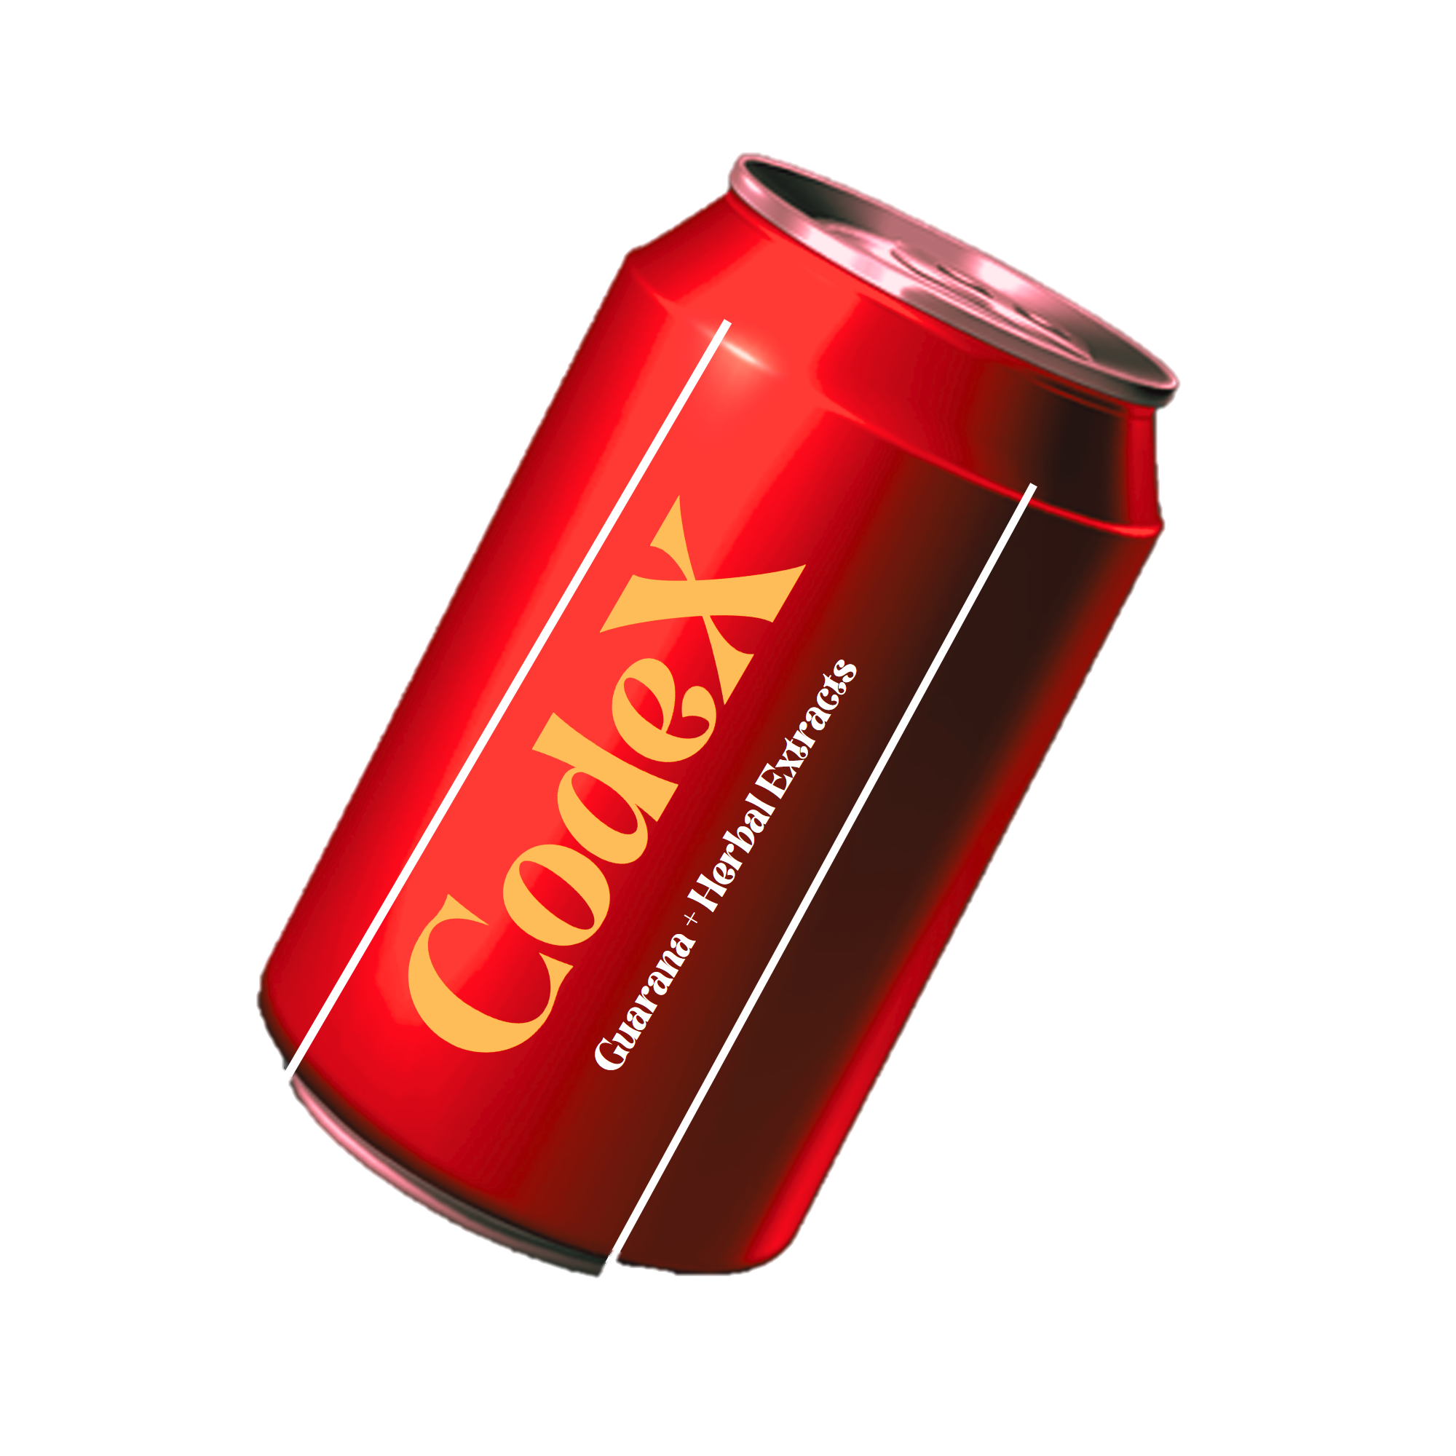
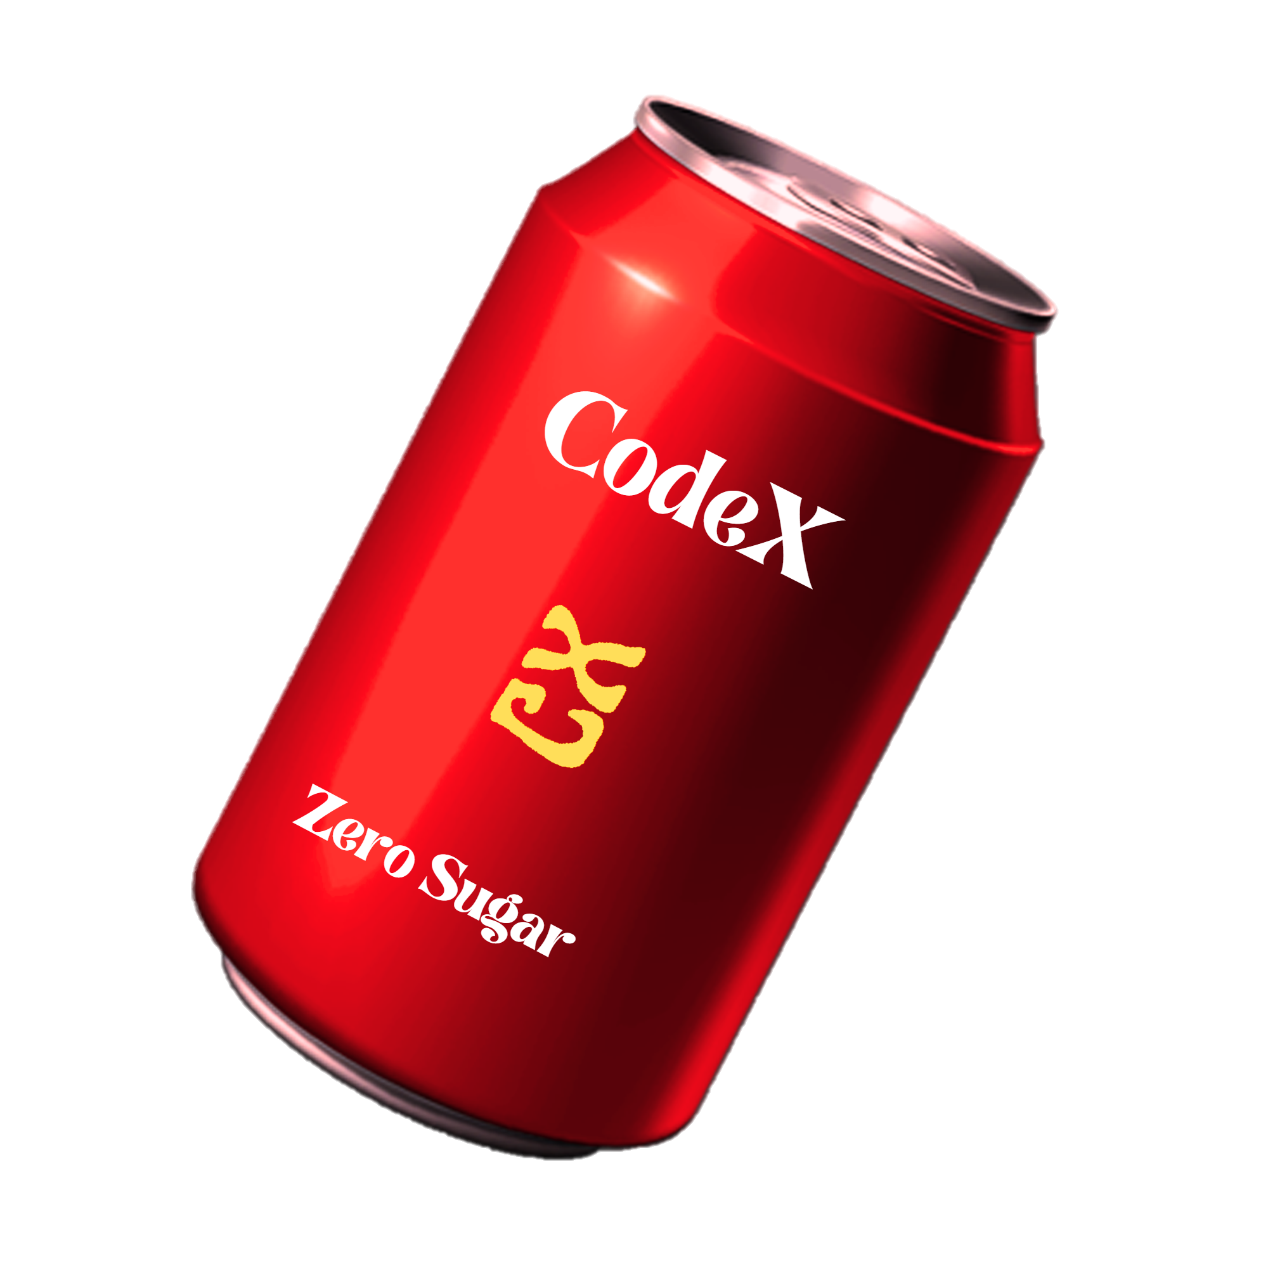
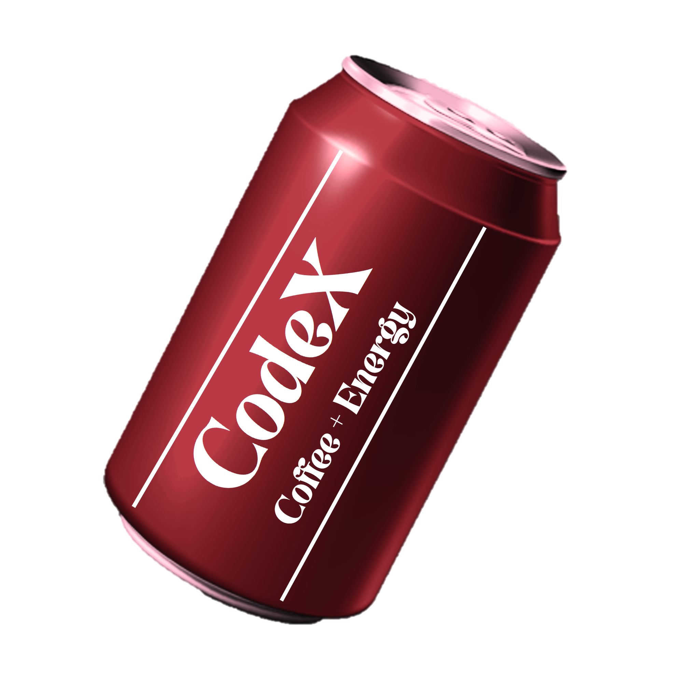
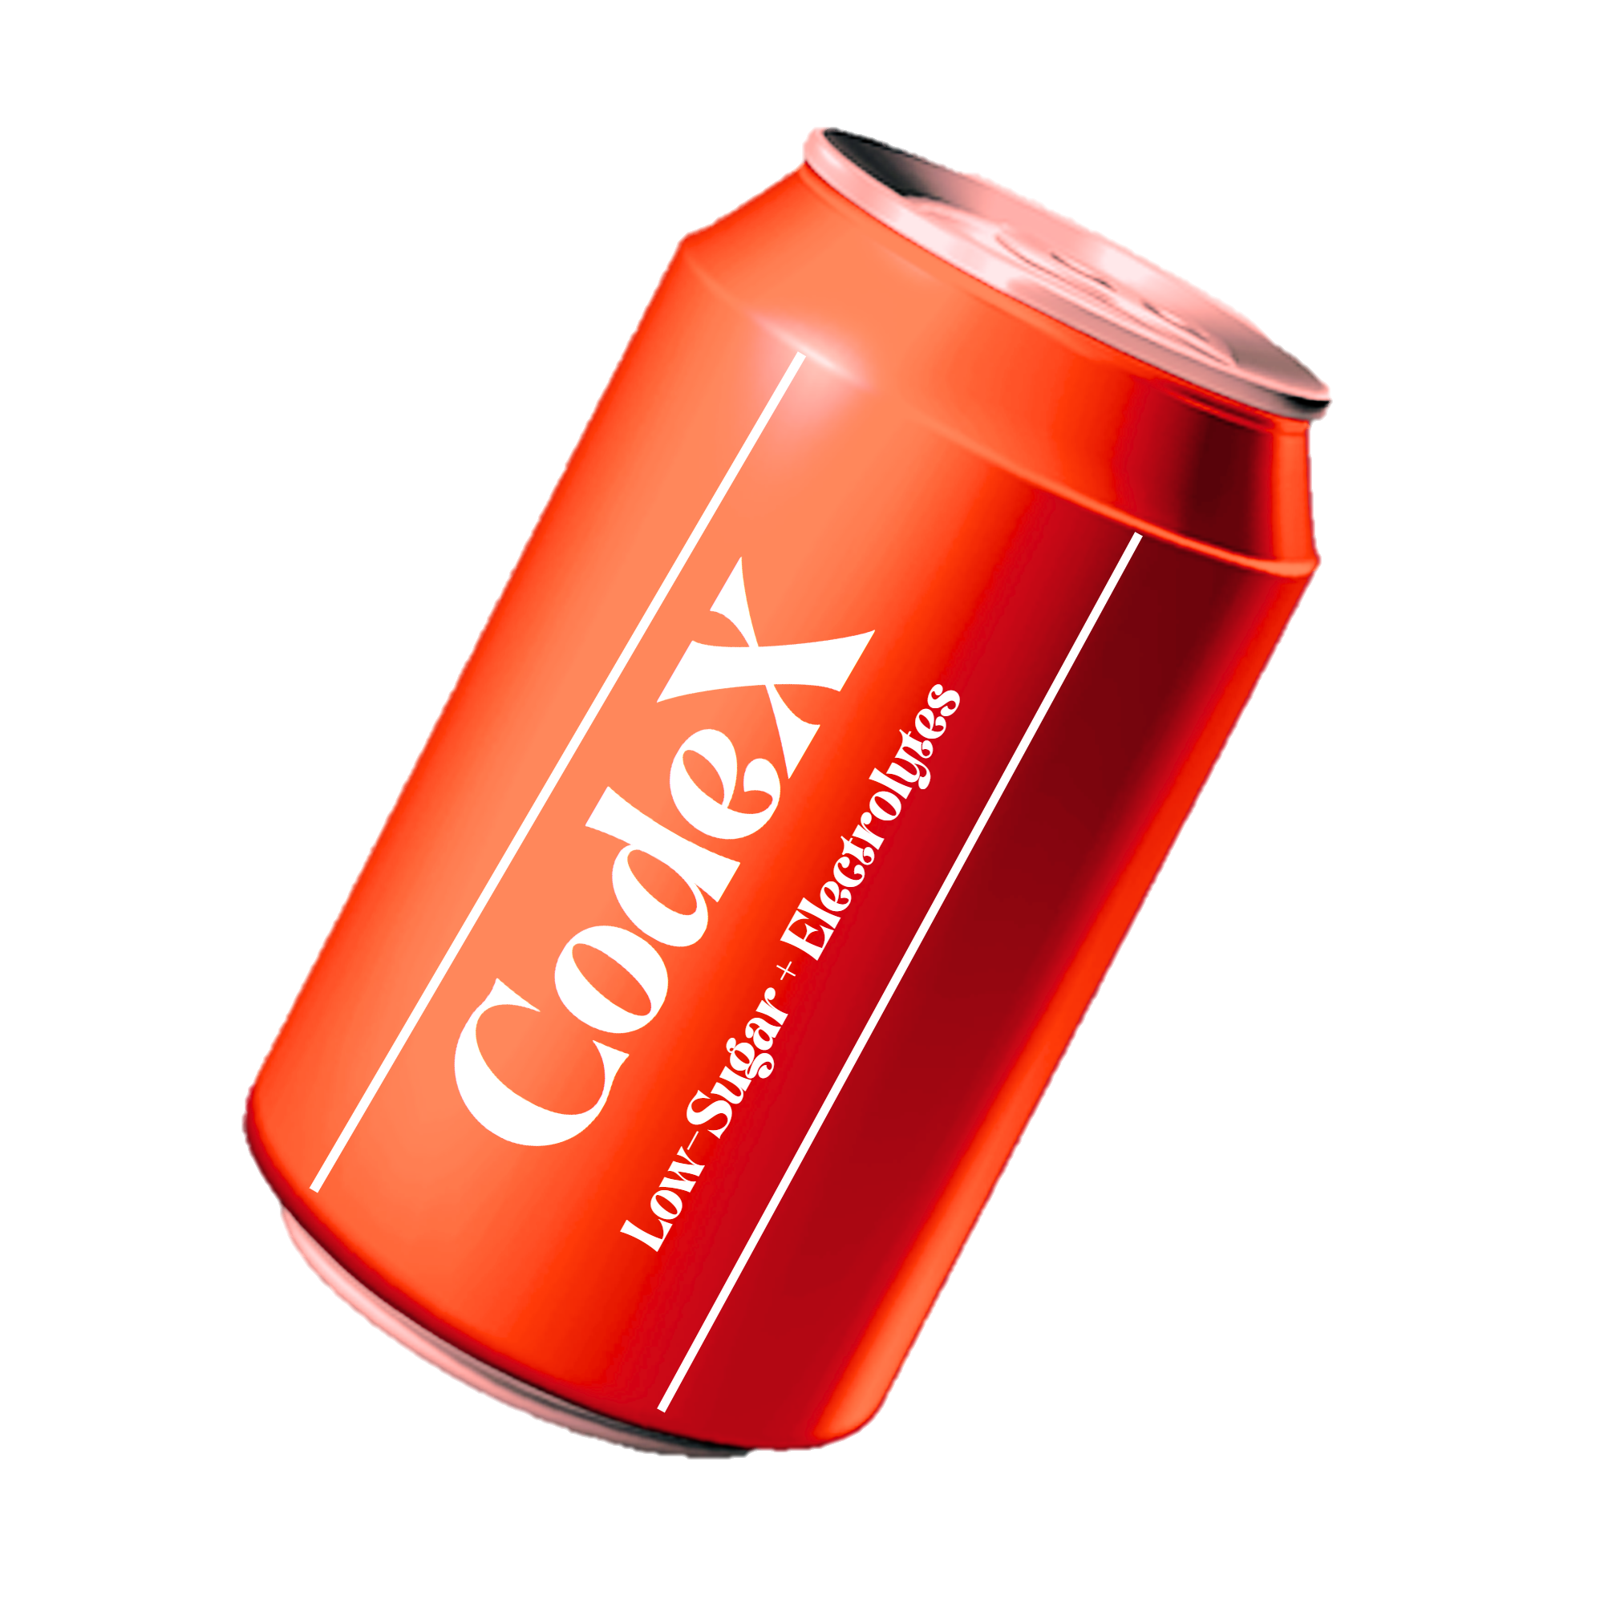
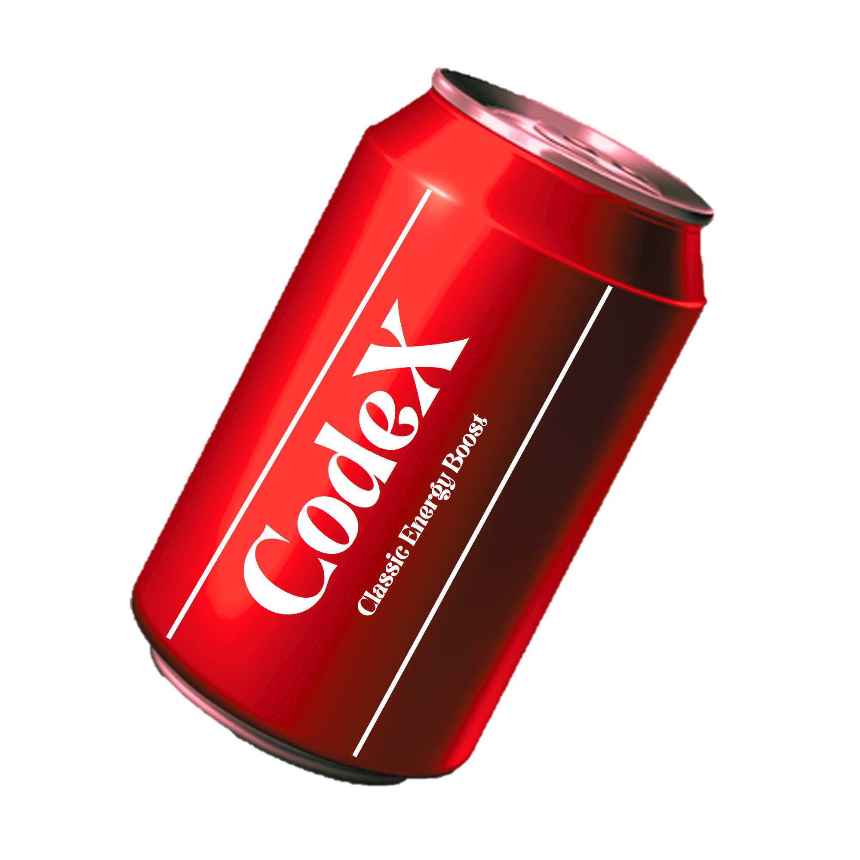
Product Diversification:
To drive market growth and cater to diverse consumer preferences, we can expand our offerings by introducing new flavors, formulations, and variants into the market.

Slide 32
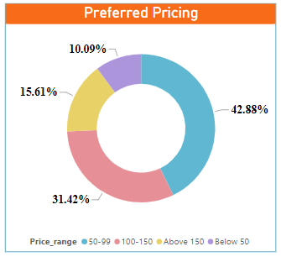
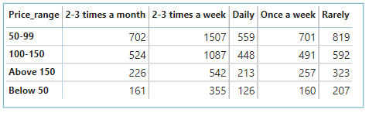
Pricing Strategy:
What should be the ideal price of our product?
Combine competitive pricing with a strong value proposition and set the price range within 50 -150, so we can position our brand as both affordable and valuable.
This strategy can attract a wider range of consumers, including price-sensitive individuals and those seeking higher quality, thereby increasing brand reputation.

Slide 33
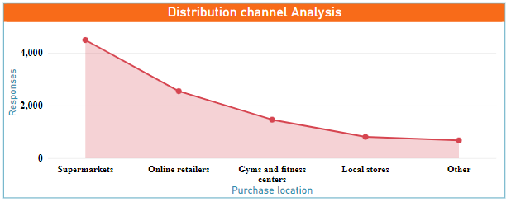
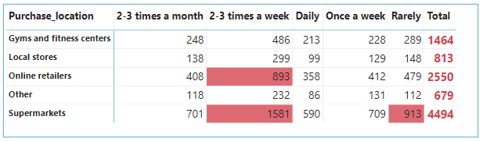
Distribution Channel Analysis:
Our strategic focus will be on Super Markets, which serve as key distribution channels with high consumer footfall.
Super markets – Bundle pricing, Pay day sale, Year end sale
Expand reach - Partnering with online retailers and fitness centers.

Slide 34
Other Recommendations:
Customization Options: Personalize packaging to create a stronger connection with customers.
Sampling Programs: Offer free product samples at relevant locations to generate awareness and word-of-mouth.
Recycling challenge : Provide incentives for customers to return empty cans, promoting sustainability.
Customer Loyalty Programs: Reward loyal customers with exclusive benefits to encourage repeat purchases.
Gamification: Engage customers through interactive games or challenges related to fitness and energy.

Slide 35
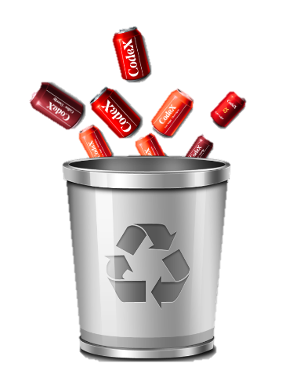
Sample Strategy implemented by Market leader:
Social Proof Marketing
Trash the empty cans and randomly place them in recyclable garbage bins across the city at pulse points.
Generate buzz, surprise consumers, and amplify brand visibility
Benefits include novelty, social media buzz, viral potential, and reinforcing our brand identity.

Slide 36
THANK
YOU
Venkata Naga Sai Munagala nagasai1836@gmail.com

